Slide 1
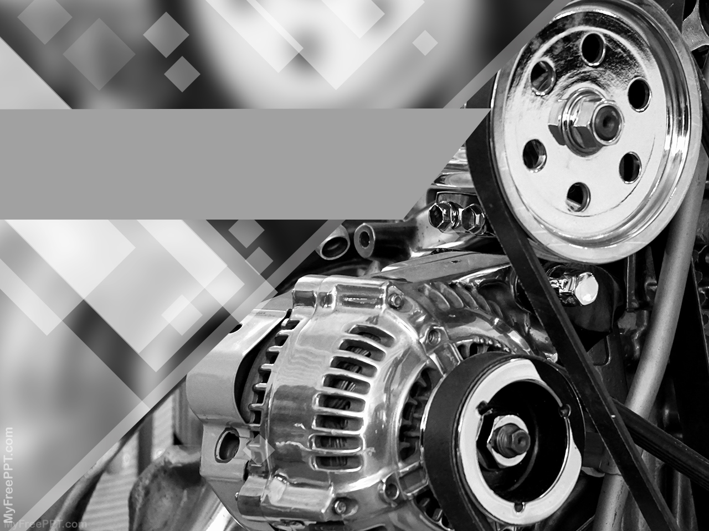
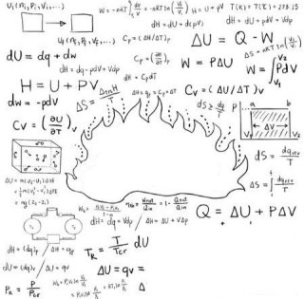
Your Title Here
Motoare Termice
Istorie
Ciocan Ana Maria
Vasile Mihaela Alina

Slide 2
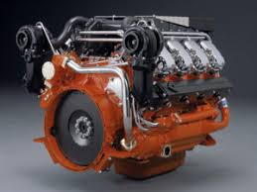
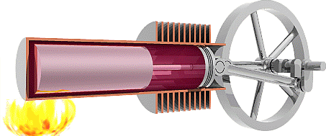
Definitie
Un motor termic este o masina care transforma caldura in lucru mecanic.

Slide 3
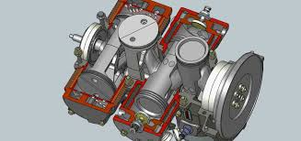
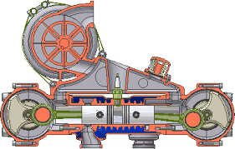
Clasificare
Motoare cu ardere interna
2. Motoare cu ardere externa

Slide 4
Istoric

Slide 5
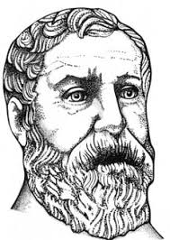
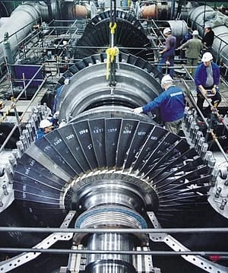
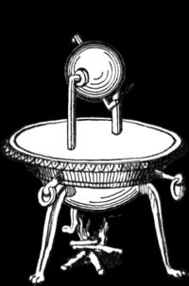
Turbina cu aburi
Heron din Alexandria

Slide 6
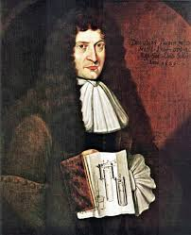
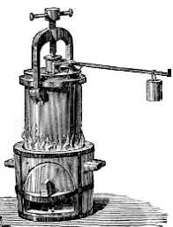
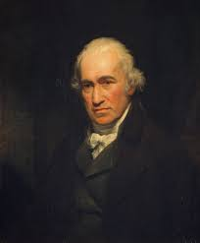
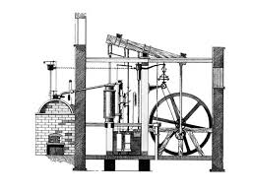
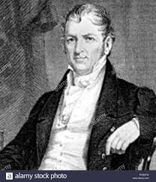
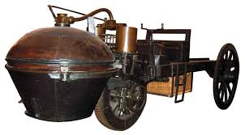
Motorul cu vapori
Denis Papin-1679/1707
James Watt-1776
Nicolas Cugnot-1769

Slide 7
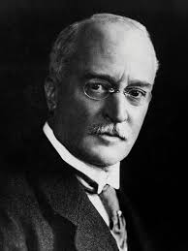
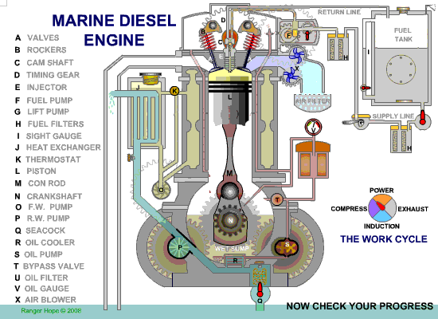
Motorul Diesel
Rudolf Diesel

Slide 8
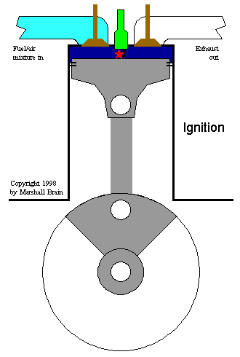
Motorul Otto

Slide 9
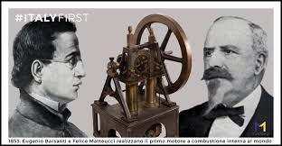
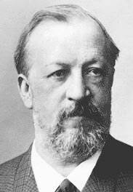
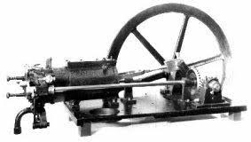
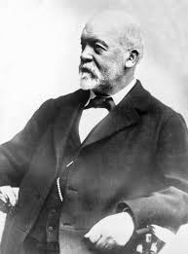
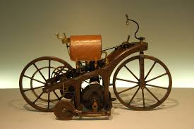
Motorul Otto
1854-Eugenio Bassati - 1860
Felice Matteucci
1876-Nikolaus Otto
1885-Gottlieb Daimler

Slide 10
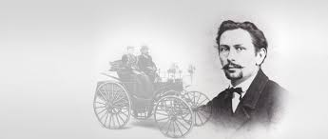
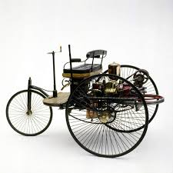
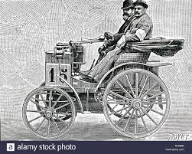
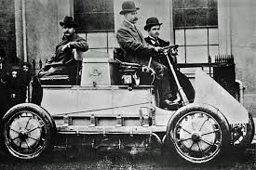
1886-Gottlieb Daimler
1890-Rene Panhard
Emile Levassor
1885-Karl Benz
1900-Lohner Porche

Slide 11
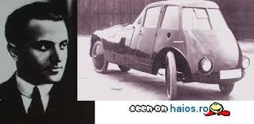
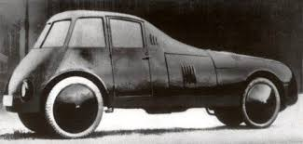
1923-Aurel Persu

Slide 12
Bibliografie
https://prezi.com/k8zoqvsxyzrg/istoria-motoarelor-termice/
https://motoaretermicenat.weebly.com/scurt-istoric.html#
https://www.slideshare.net/BarbulescuAlex/motoare-termice-48280451?qid=1f438ece-ba0f-4610-ac89-a75095cb689d&v=&b=&from_search=5
https://evolutiamotoarelor.weebly.com/motoarele-cu-ardere-externa.html
https://www.google.com/search?q=motorul+otto&tbm=isch&ved=2ahUKEwjM84H89fHlAhUbIFAKHSSOBf0Q2-cCegQIABAA&oq=motorul+otto&gs_l=img.3..0j0i30l3j0i24l2.48318.50885
https://www.google.com/search?q=motorul+otto&tbm=isch&ved=2ahUKEwjM84H89fHlAhUbIFAKHSSOBf0Q2-cCegQIABAA&oq=motorul+otto&gs_l=img.3..0j0i30l3j0i24l2.48318.50885..51076...1.0..0.316.1749.0j11j0j1......0....1..gws-wiz-img.....10..35i362i39j35i39j0i67j0i10.Mp4NIHtcqjg&ei=mZfRXYzDOJvAwAKknJboDw&bih=657&biw=1024#imgrc=xZ--fozp6gUcDM

Slide 13


